Slide 1

CSCI 1720
Intermediate Web Design
Bootstrap – Part 1
East Tennessee State University
Department of Computing
CSCI 1720
Intermediate Web Design

Slide 2
Responsive Design

Slide 3
Responsive Design: What’s the Big Deal?
Some statistics (…as of 2016):
There are more mobile internet users than desktop internet users; 52.7% of global internet users access the internet via mobile, and 75.1% of U.S. internet users access the internet via mobile
Mobile media time in the U.S. has exceeded desktop, with mobile media time estimated to be 51% while desktop media time is estimated to be 42%. Mobile advertising spend is projected to account for 60.4% of all digital advertising spend by 2016 and 72.2% of all digital advertising spend by 2019
In 2015, mobile influenced retail sales to the tune of over $1 trillion
East Tennessee State University
Department of Computing
CSCI 1720
Intermediate Web Design

Slide 4
Responsive Design: What’s the Big Deal?
Some statistics (…as of 2016):
Search engines are the starting point for mobile research, with an estimated 48% of mobile internet users starting their search on search engines
Consequently, the #1 search engine, Google started to significantly use mobile compatibility as a factor when ranking websites. 4 out of 5 consumers use a Smartphone to shop
70% of mobile searches result in an online action within an hour of the search being conducted
50% of mobile users will abandon of web page if it takes more than 10 seconds to load, and 60% won’t return to the site
East Tennessee State University
Department of Computing
CSCI 1720
Intermediate Web Design

Slide 5
Responsive Design: What’s the Big Deal?
The real eye-catcher:
75.1% of U.S. internet users access the internet via mobile
(!)
East Tennessee State University
Department of Computing
CSCI 1720
Intermediate Web Design

Slide 6
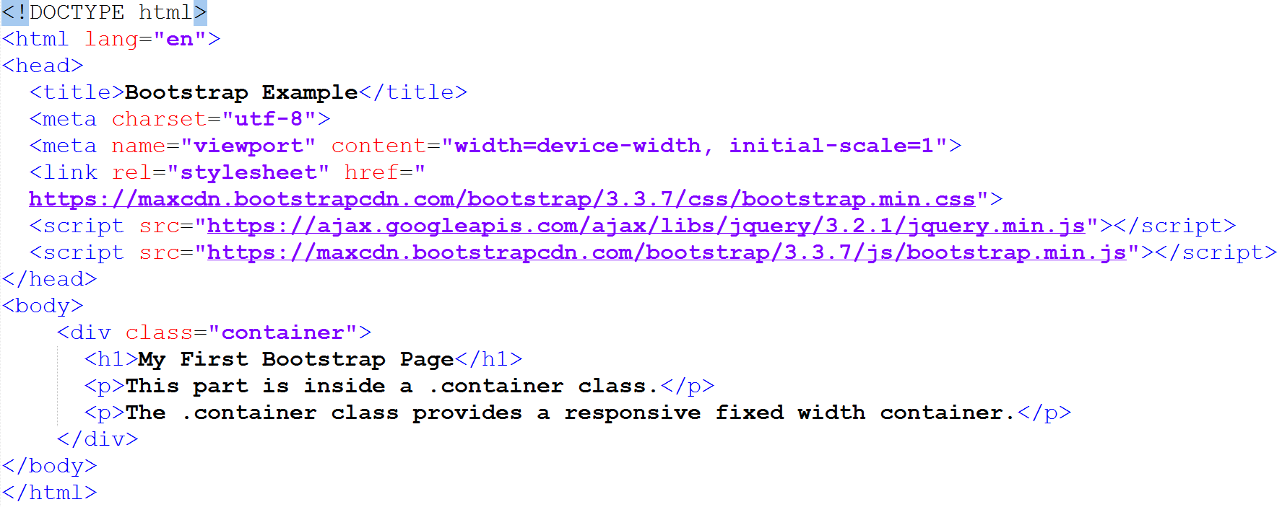
Responsive Design
Bootstrap (and other CSS frameworks) provide responsive design ‘out of the box’
Still a few requirements:
This meta-element is included in the Bootstrap template file
“viewport” uses the device’s display width
width=device-width sets the page’s display width to the device’s display width
initial-scale=1 instructs the browser to establish a 1:1 relationship between CSS pixels and device-independent pixels regardless of the device’s orientation
East Tennessee State University
Department of Computing
CSCI 1720
Intermediate Web Design

Slide 7
Responsive Design
Other things to note:
Do not use large fixed width elements
Content should not rely on a particular viewport width to render well
Use CSS media queries to apply different styling for small and large screens
Bootstrap takes care of these issues for you
East Tennessee State University
Department of Computing
CSCI 1720
Intermediate Web Design

Slide 8
What is Bootstrap?
Bootstrap is a free front-end framework for faster and easier web development
Bootstrap includes HTML and CSS based design templates for typography, forms, buttons, tables, navigation, modals, image carousels and many others, as well as optional JavaScript plugins
Bootstrap also gives you the ability to easily create responsive designs
East Tennessee State University
Department of Computing
CSCI 1720
Intermediate Web Design

Slide 9
What is Responsive Web Design?
Responsive web design is about creating web sites which automatically adjust themselves to look good on all devices, from small phones to large desktops
East Tennessee State University
Department of Computing
CSCI 1720
Intermediate Web Design

Slide 10
Bootstrap History
Bootstrap was developed by Mark Otto and Jacob Thornton at Twitter, and released as an open source product in August 2011 on GitHub
In June 2014 Bootstrap was the No.1 project on GitHub
Bootstrap was created at Twitter in mid-2010
Prior to being an open-sourced framework, Bootstrap was known as Twitter Blueprint
East Tennessee State University
Department of Computing
CSCI 1720
Intermediate Web Design

Slide 11
Bootstrap History
A few months into development, Twitter held its first Hack Week and the project exploded as developers of all skill levels jumped in without any external guidance
It served as the style guide for internal tools development at the company for over a year before its public release, and continues to do so today
East Tennessee State University
Department of Computing
CSCI 1720
Intermediate Web Design

Slide 12
Bootstrap History
Originally released on Friday, August 19, 2011, there have since been over twenty releases, including two major rewrites with v2 and v3 (and now, v4.1.3 5)
With Bootstrap 2, added responsive functionality to the entire framework as an optional stylesheet
Building on that with Bootstrap 3, rewrote the library once more to make it responsive by default with a mobile first approach
East Tennessee State University
Department of Computing
CSCI 1720
Intermediate Web Design

Slide 13
Why Use Bootstrap?
Advantages of Bootstrap:
Easy to use: Anybody with just basic knowledge of HTML and CSS can start using Bootstrap
Responsive features: Bootstrap's responsive CSS adjusts to phones, tablets, and desktops
Mobile-first approach: In Bootstrap 3, mobile-first styles are part of the core framework
Browser compatibility: Bootstrap is compatible with all modern browsers (Chrome, Firefox, Internet Explorer, Safari, and Opera)
East Tennessee State University
Department of Computing
CSCI 1720
Intermediate Web Design

Slide 14
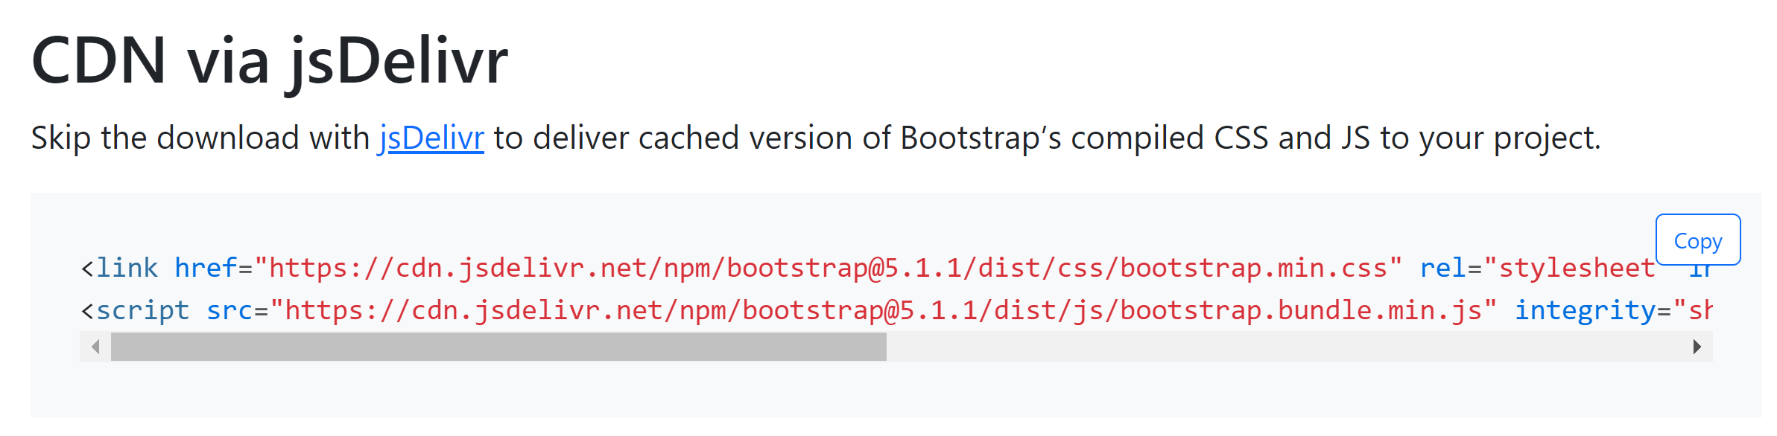
Where to Get Bootstrap?
Download Bootstrap
from getbootstrap.com
Include Bootstrap from a CDN
East Tennessee State University
Department of Computing
CSCI 1720
Intermediate Web Design

Slide 15
Why Use Bootstrap?
One advantage of using the Bootstrap CDN*:
Many users already have downloaded Bootstrap from MaxCDN when visiting another site. As a result, it will be loaded from cache when they visit your site, which leads to faster loading time
Also, most CDNs will make sure that once a user requests a file from it, it will be served from the server closest to them, which also leads to faster loading time
* CDN == ‘Content Delivery Network’
East Tennessee State University
Department of Computing
CSCI 1720
Intermediate Web Design

Slide 16
Why Use Bootstrap?
jQuery
Bootstrap uses jQuery for JavaScript plugins (like modals, tooltips, etc)
However, if you just use the CSS part of Bootstrap, you don't need jQuery
East Tennessee State University
Department of Computing
CSCI 1720
Intermediate Web Design

Slide 17
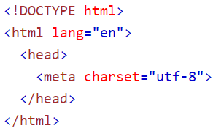
Create First Web Page With Bootstrap
1. Add the HTML5 doctype
Bootstrap uses HTML elements and CSS properties that require the HTML5 doctype
Always include the HTML5 doctype at the beginning of the page, along with the lang attribute and the correct character set:
East Tennessee State University
Department of Computing
CSCI 1720
Intermediate Web Design

Slide 18
Create First Web Page With Bootstrap
2. Bootstrap 3+ is mobile-first
Bootstrap 3 is designed to be responsive to mobile devices. Mobile-first styles are part of the core framework
To ensure proper rendering and touch zooming, add the following <meta> tag inside the <head> element:
East Tennessee State University
Department of Computing
CSCI 1720
Intermediate Web Design

Slide 19
Create First Web Page With Bootstrap
2. The width=device-width part sets the width of the page to follow the screen-width of the device (which will vary depending on the device)
The initial-scale=1 part sets the initial zoom level when the page is first loaded by the browser
East Tennessee State University
Department of Computing
CSCI 1720
Intermediate Web Design

Slide 20
Create First Web Page With Bootstrap
3. Containers
Bootstrap also requires a containing element to wrap site contents
There are two container classes to choose from:
The .container class provides a responsive fixed width container
The .container-fluid class provides a full width container, spanning the entire width of the viewport
Note: Containers are not nestable (you cannot put a container inside another container)
East Tennessee State University
Department of Computing
CSCI 1720
Intermediate Web Design

Slide 21
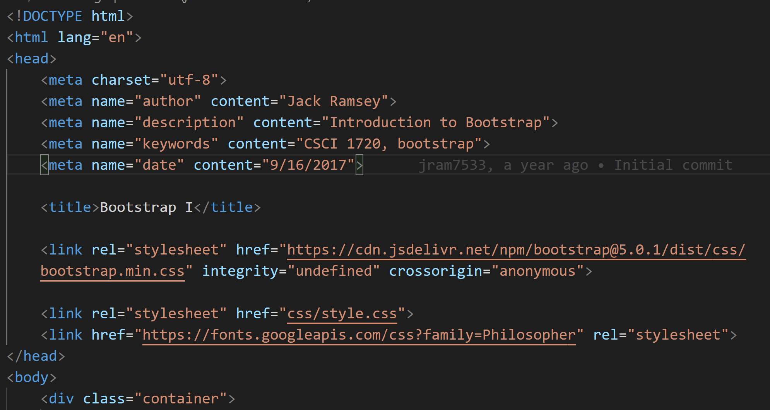
East Tennessee State University
Department of Computing
CSCI 1720
Intermediate Web Design

Slide 22
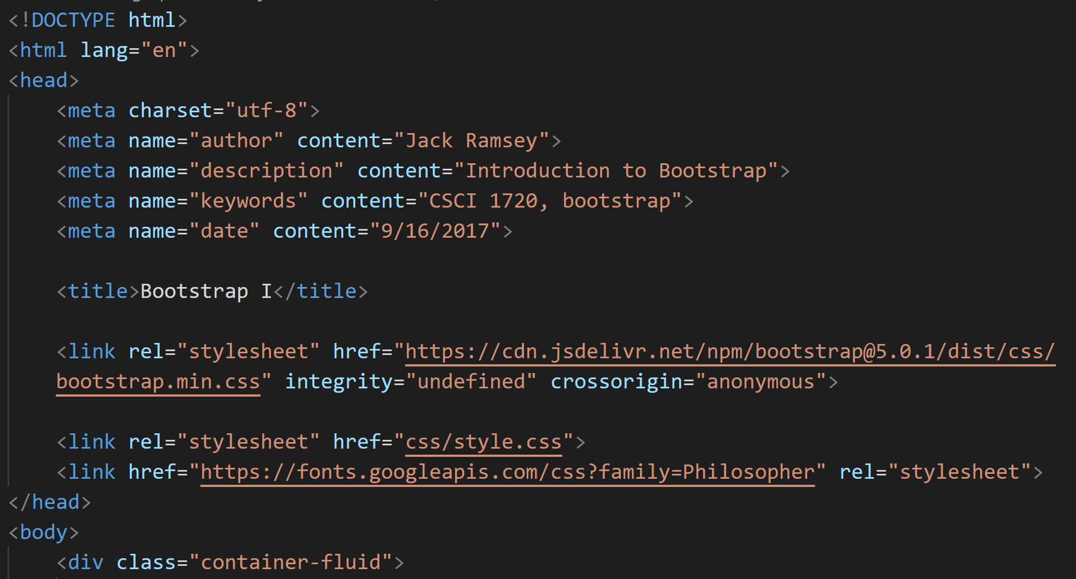
Remember, you’ll set up a template page so that you only
have to type this part once, then each new page will start
with your template
East Tennessee State University
Department of Computing
CSCI 1720
Intermediate Web Design

Slide 23
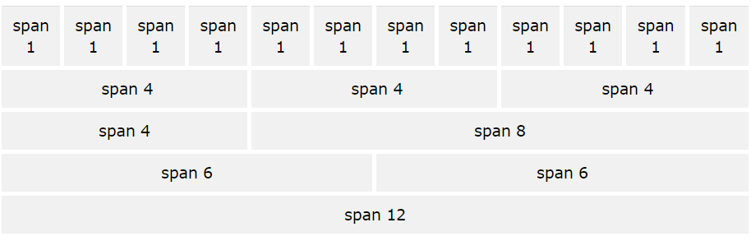
Bootstrap Grids
Bootstrap's grid system allows up to 12 columns across the page
If you do not want to use all 12 columns individually, you can group the columns together to create wider columns:
East Tennessee State University
Department of Computing
CSCI 1720
Intermediate Web Design

Slide 24
Bootstrap Grids
Bootstrap's grid system is responsive, and the columns will re-arrange automatically depending on the screen size
East Tennessee State University
Department of Computing
CSCI 1720
Intermediate Web Design

Slide 25
Bootstrap Grids - Grid Classes
The Bootstrap grid system has five classes:
.col- (extra small devices - screen width less than 576px)
.col-sm- (small devices - screen width equal to or greater than 576px)
.col-md- (medium devices - screen width equal to or greater than 768px)
.col-lg- (large devices - screen width equal to or greater than 992px)
.col-xl- (xlarge devices - screen width equal to or greater than 1200px)
The classes above can be combined to create more dynamic and flexible layouts (more later)
East Tennessee State University
Department of Computing
CSCI 1720
Intermediate Web Design

Slide 26
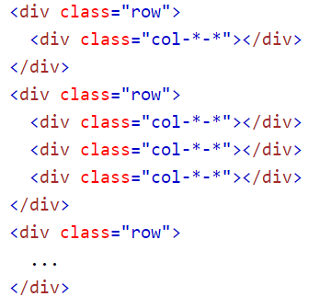
Basic Structure of a Bootstrap Grid
First; create a row
<div class="row">
Then, add the desired number of columns (tags with appropriate
.col-*-* classes)
Note that numbers in .col-*-* should always add up to 12 for each row
East Tennessee State University
Department of Computing
CSCI 1720
Intermediate Web Design

Slide 27
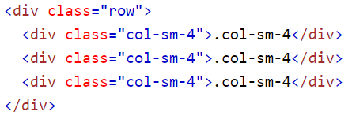
Example: Three Equal Columns
First; create a row
<div class="row">
Then, add the columns
class=“col-sm-4”
East Tennessee State University
Department of Computing
CSCI 1720
Intermediate Web Design

Slide 28
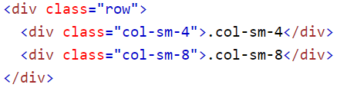
Example: Two Unequal Columns
First; create a row
<div class="row">
Then, add the columns
class=“col-sm-4”
class=“col-sm-8”
East Tennessee State University
Department of Computing
CSCI 1720
Intermediate Web Design

Slide 29
Bootstrap Grid System Rules
Rows are placed within a .container (fixed-width) or .container-fluid (full-width) for proper alignment and padding
Use rows to create horizontal groups of columns
Content should be placed within columns, and only columns may be immediate children of rows
East Tennessee State University
Department of Computing
CSCI 1720
Intermediate Web Design

Slide 30
Bootstrap Grid System Rules
Predefined classes like .row and .col-sm-4 are available for quickly making grid layouts
Columns create gutters (gaps between column content) via padding. That padding is offset in rows for the first and last column via negative margin on .rows
Grid columns are created by specifying the number of 12 available columns you wish to span. For example, three equal columns would use three .col-sm-4
East Tennessee State University
Department of Computing
CSCI 1720
Intermediate Web Design

Slide 31
Responsive Design and Bootstrap’s Grid
Earlier, we discussed the fact that there are five classes associated with Bootstrap’s grid system:
col-
col-xs (for phones) col-sm (for tablets)
col-md (for desktops) col-lg (for larger desktops)
So, what’s the difference / which one should we use?
East Tennessee State University
Department of Computing
CSCI 1720
Intermediate Web Design

Slide 32
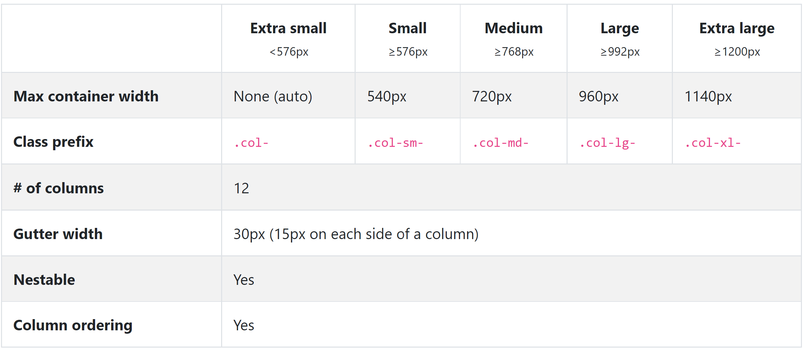
xs / sm / md / lg – A Comparison
East Tennessee State University
Department of Computing
CSCI 1720
Intermediate Web Design

Slide 33
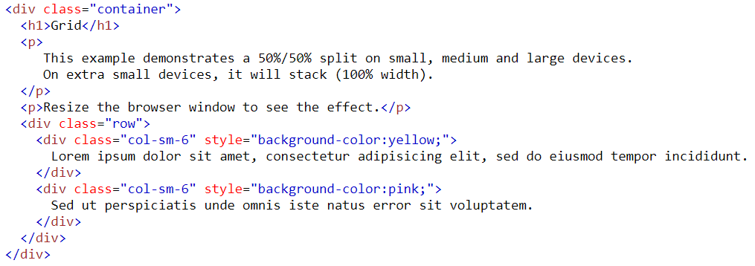
Grid Example
East Tennessee State University
Department of Computing
CSCI 1720
Intermediate Web Design

Slide 34
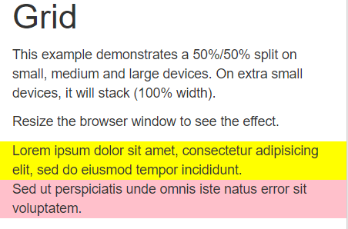
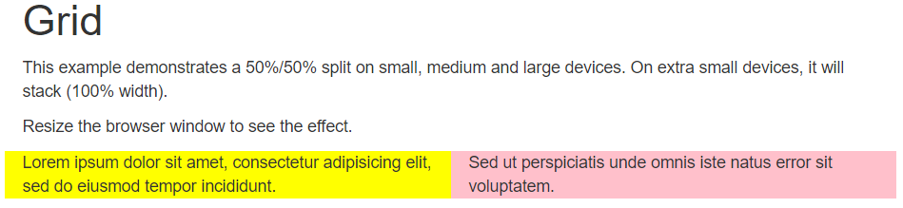
Grid Example
vs.
East Tennessee State University
Department of Computing
CSCI 1720
Intermediate Web Design

Slide 35
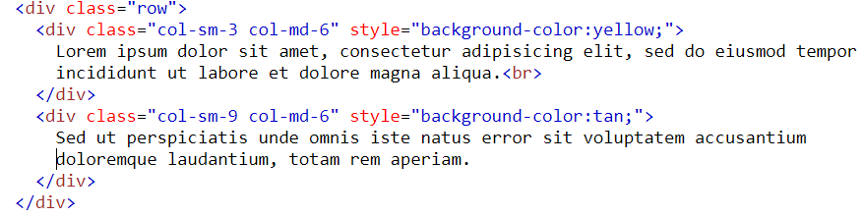
Responsive Design and Bootstrap’s Grid
Multiple classes can be used to modify the grid layout based on device size
For example, we may decide that a 25%/75% split would look good on a small device, but 50%/50% would look better on medium (and large) devices
So we could do this:
Note sm: 3+9=12
md: 6+6=12
East Tennessee State University
Department of Computing
CSCI 1720
Intermediate Web Design

Slide 36
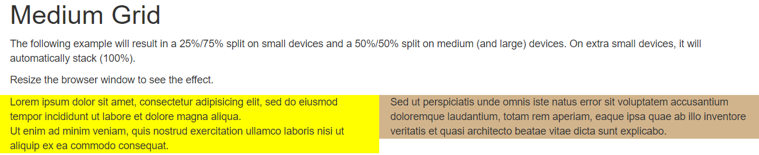
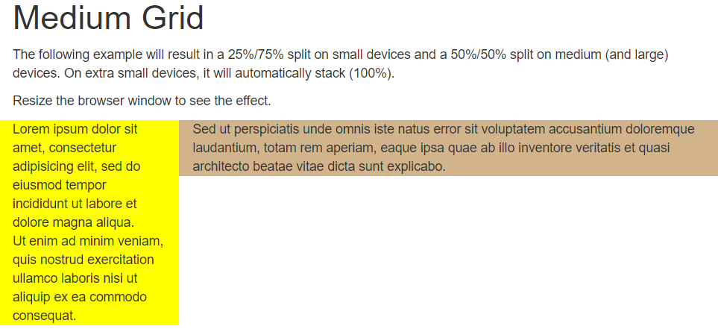
Grid Example
vs.
East Tennessee State University
Department of Computing
CSCI 1720
Intermediate Web Design

Slide 37

Responsive Design and Bootstrap’s Grid
Likewise, we could define different ratios for (xs &) sm, md, and lg displays:
Once again: sm: 3+9=12
md: 6+6=12
lg: 4+8=12
East Tennessee State University
Department of Computing
CSCI 1720
Intermediate Web Design

Slide 38
Responsive Design and Bootstrap’s Grid
Note:
Typically, the md class works fine across devices
Anything smaller than a laptop/desktop will simply stack the content
On smaller displays, however, navbars take up too much space
East Tennessee State University
Department of Computing
CSCI 1720
Intermediate Web Design

Slide 39
Bootstrap Navbars

Slide 40
Bootstrap Navigation Bars
A navigation bar is a navigation header that is placed at the top of the page:
With Bootstrap, a navigation bar can extend or collapse, depending on the screen size
A standard navigation bar is created with
<nav class="navbar navbar-default">
We can include the website’s name (or logo) as part of the navbar:
East Tennessee State University
Department of Computing
CSCI 1720
Intermediate Web Design

Slide 41
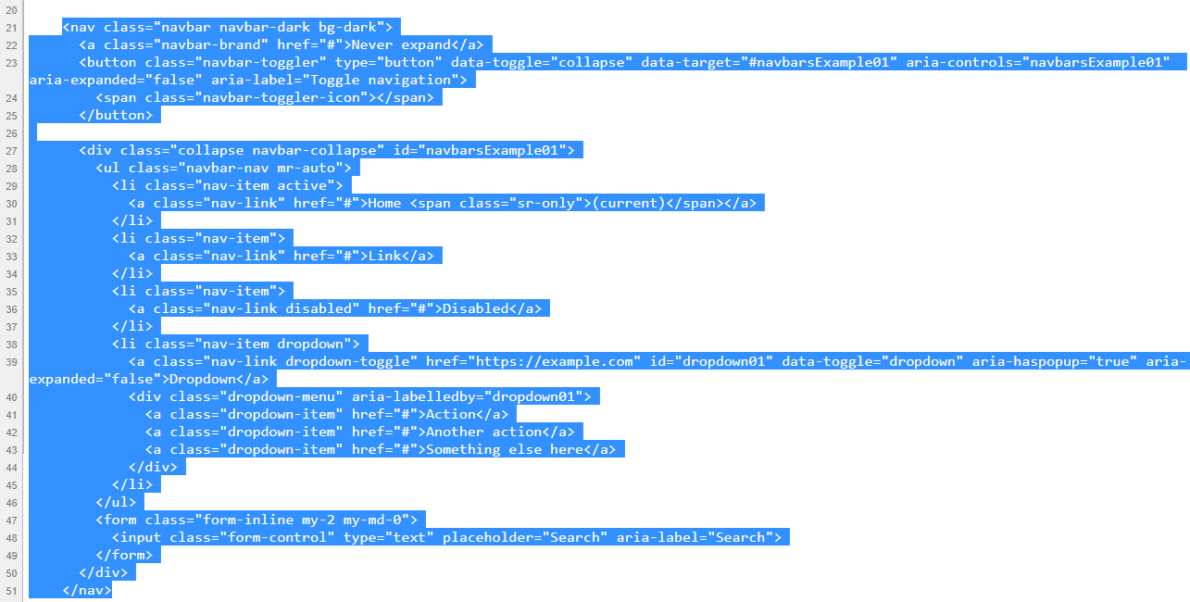
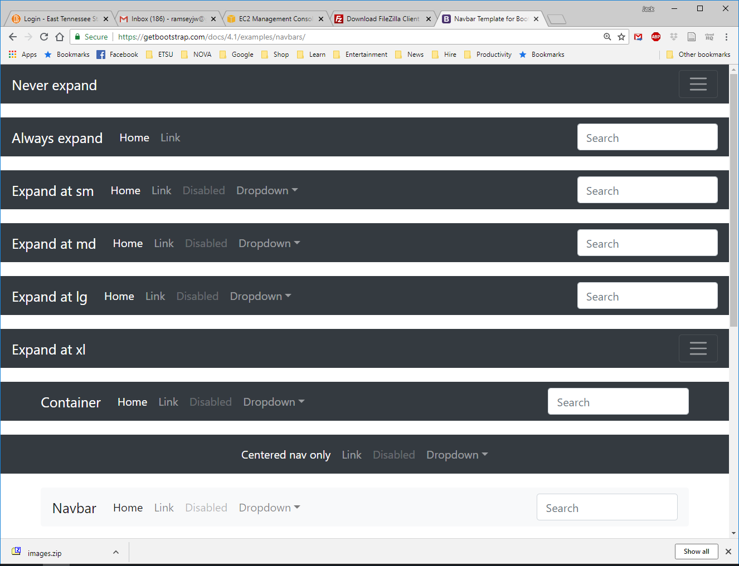
Bootstrap Navigation Bars
https://getbootstrap.com/docs/5.0/examples/navbars/
East Tennessee State University
Department of Computing
CSCI 1720
Intermediate Web Design

Slide 42
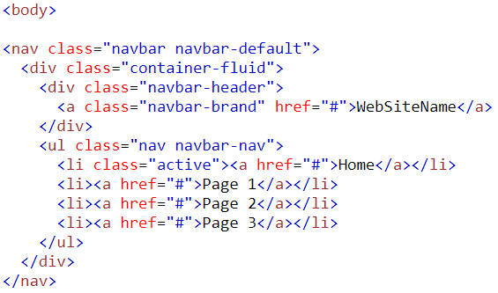
Bootstrap Navigation Bars
Navbar declaration
Makes navbar resize
Website name
List of links
East Tennessee State University
Department of Computing
CSCI 1720
Intermediate Web Design

Slide 43
Bootstrap Navigation Bars
But, what if the display device is small (tablet) or extra-small (smart phone)?
It gets a little more complicated:
East Tennessee State University
Department of Computing
CSCI 1720
Intermediate Web Design

Slide 44
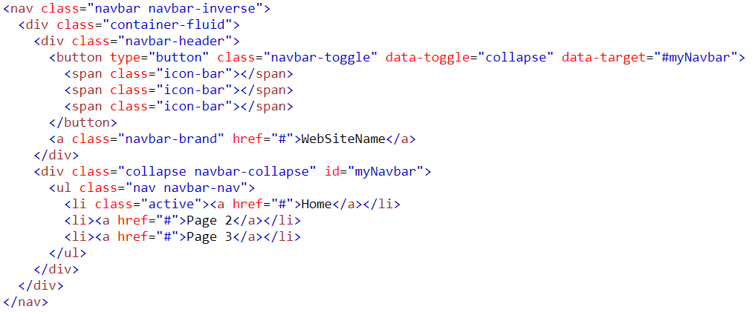
Bootstrap Navigation Bars
Navbar declaration
Makes navbar resize
Creates the button
on small displays
Website name
List of links
navbar-collapse instead of navbar-default
East Tennessee State University
Department of Computing
CSCI 1720
Intermediate Web Design

Slide 45
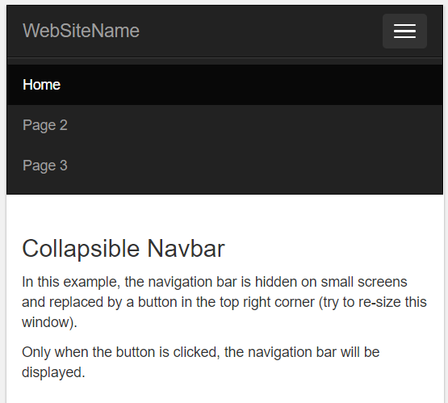
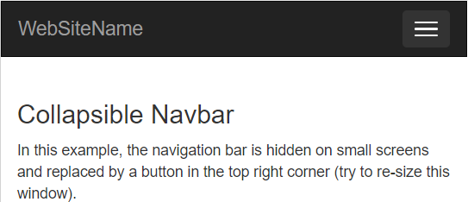
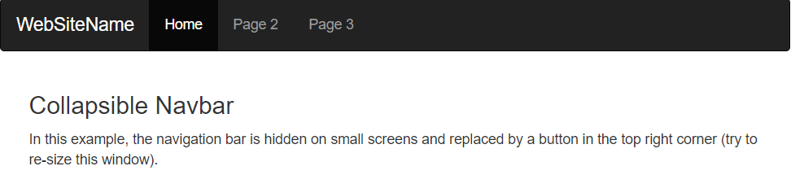
Bootstrap Navigation Bars
East Tennessee State University
Department of Computing
CSCI 1720
Intermediate Web Design

Slide 46
Bootstrap Typography

Slide 47
Bootstrap Typography
Default Settings
Bootstrap's global default font-size is 14px, with a line-height of 1.428
This is applied to the <body> element and all paragraphs (<p>)
In addition, all <p> elements have a bottom margin that equals half their computed line-height (10px by default)
East Tennessee State University
Department of Computing
CSCI 1720
Intermediate Web Design

Slide 48
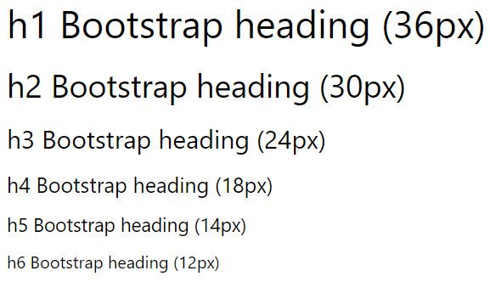
Bootstrap Typography - <h1> - <h6>
By default, Bootstrap will style the HTML headings (<h1> to <h6>) in the following way
East Tennessee State University
Department of Computing
CSCI 1720
Intermediate Web Design

Slide 49
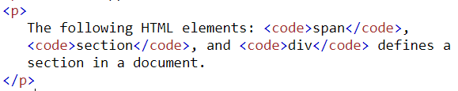
Bootstrap Typography - others
East Tennessee State University
Department of Computing
CSCI 1720
Intermediate Web Design

Slide 50
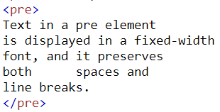
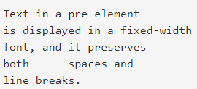
Bootstrap Typography - others
East Tennessee State University
Department of Computing
CSCI 1720
Intermediate Web Design

Slide 51
Bootstrap Typography – Contextual Colors and Backgrounds
Bootstrap also has some contextual classes that can be used to provide "meaning through colors"
The classes for text colors are:.text-muted, .text-primary, .text-success, .text-info, .text-warning, and .text-danger:
East Tennessee State University
Department of Computing
CSCI 1720
Intermediate Web Design

Slide 52
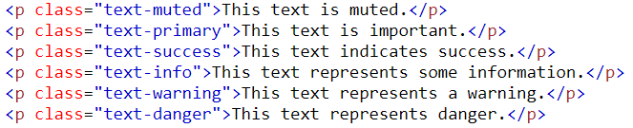
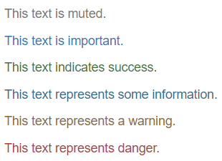
Bootstrap Typography – Contextual Colors and Backgrounds
East Tennessee State University
Department of Computing
CSCI 1720
Intermediate Web Design

Slide 53
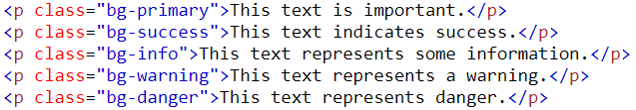
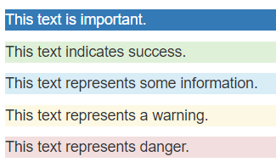
Bootstrap Typography – Contextual Colors and Backgrounds
East Tennessee State University
Department of Computing
CSCI 1720
Intermediate Web Design

Slide 54
Bootstrap Typography
These are some of the more common Bootstrap typography classes
For more information, visit
https://www.w3schools.com/bootstrap/bootstrap_ref_css_helpers.asp
East Tennessee State University
Department of Computing
CSCI 1720
Intermediate Web Design

Slide 55
Sources
https://www.w3schools.com/bootstrap/bootstrap_get_started.asp
http://getbootstrap.com/about/
https://hostingfacts.com/internet-facts-stats-2016/
https://developers.google.com/web/fundamentals/design-and-ui/responsive/
East Tennessee State University
Department of Computing
CSCI 1720
Intermediate Web Design

Slide 56


Copyrights
Presentation prepared by and copyright of John Ramsey, East Tennessee State University, Department of Computing . (ramseyjw@etsu.edu)
Microsoft, Windows, Excel, Outlook, and PowerPoint are registered trademarks of Microsoft Corporation.
IBM, DB2, DB2 Universal Database, System i, System i5, System p, System p5, System x, System z, System z10, System z9, z10, z9, iSeries, pSeries, xSeries, zSeries, eServer, z/VM, z/OS, i5/OS, S/390, OS/390, OS/400, AS/400, S/390 Parallel Enterprise Server, PowerVM, Power Architecture, POWER6+, POWER6, POWER5+, POWER5, POWER, OpenPower, PowerPC, BatchPipes, BladeCenter, System Storage, GPFS, HACMP, RETAIN, DB2 Connect, RACF, Redbooks, OS/2, Parallel Sysplex, MVS/ESA, AIX, Intelligent Miner, WebSphere, Netfinity, Tivoli and Informix are trademarks or registered trademarks of IBM Corporation.
Linux is the registered trademark of Linus Torvalds in the U.S. and other countries.
Oracle is a registered trademark of Oracle Corporation.
HTML, XML, XHTML and W3C are trademarks or registered trademarks of W3C®, World Wide Web Consortium, Massachusetts Institute of Technology.
Java is a registered trademark of Sun Microsystems, Inc.
JavaScript is a registered trademark of Sun Microsystems, Inc., used under license for technology invented and implemented by Netscape.
SAP, R/3, SAP NetWeaver, Duet, PartnerEdge, ByDesign, SAP Business ByDesign, and other SAP products and services mentioned herein as well as their respective logos are trademarks or registered trademarks of SAP AG in Germany and other countries.
Business Objects and the Business Objects logo, BusinessObjects, Crystal Reports, Crystal Decisions, Web Intelligence, Xcelsius, and other Business Objects products and services mentioned herein as well as their respective logos are trademarks or registered trademarks of Business Objects S.A. in the United States and in other countries. Business Objects is an SAP company.
ERPsim is a registered copyright of ERPsim Labs, HEC Montreal.
Other products mentioned in this presentation are trademarks of their respective owners.
East Tennessee State University
Department of Computing
CSCI 1720
Intermediate Web Design

