Slide 1


Slide 2
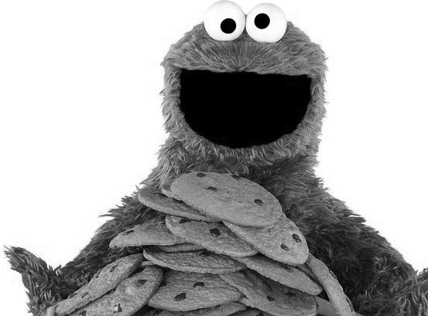
Cookies
East Tennessee State University
Department of Computing
CSCI 1720 – Intermediate Web

Slide 3
First
Understanding Stateful vs. Stateless applications

Slide 4
‘State-ful’ vs. ‘State-less’
The state of an application (or anything else, really) is its condition or quality of being at a given moment in time--its state of being
Whether something is stateful or stateless depends on how long the state of interaction with it is being recorded and how that information needs to be stored

Slide 5
‘State-ful’ vs. ‘State-less’
Stateless
A stateless process or application can be understood in isolation
There is no stored knowledge of or reference to past transactions
Each transaction is made as if from scratch for the first time
Stateless applications provide one service or function and use content delivery network (CDN), web, or print servers to process these short-term requests

Slide 6
‘State-ful’ vs. ‘State-less’
Stateless
An example of a stateless transaction would be doing a search online to answer a question you’ve thought of
You type your question into a search engine and hit enter
If your transaction is interrupted or closed accidentally, you just start a new one
Think of stateless transactions as a vending machine: a single request and a response

Slide 7
‘State-ful’ vs. ‘State-less’
Stateful
Stateful applications and processes are those that can be returned to again and again, like online banking or email
They’re performed with the context of previous transactions and the current transaction may be affected by what happened during previous transactions
For these reasons, stateful apps use the same servers each time they process a request from a user

Slide 8
‘State-ful’ vs. ‘State-less’
Stateful
If a stateful transaction is interrupted, the context and history have been stored so you can more or less pick up where you left off
Stateful apps track things like window location, setting preferences, and recent activity
You can think of stateful transactions as an ongoing periodic conversation with the same person

Slide 9
‘State-ful’ vs. ‘State-less’
Stateful
The majority of applications we use day to day are stateful, but as technology advances, microservices and containers make it easier to build and deploy applications in the cloud

Slide 10
Now…Cookies
What are they and why should we use them?

Slide 11
Cookies – A Brief History
HTTP, or the Hypertext Transfer Protocol, is a stateless protocol
According to Wikipedia, it’s a stateless protocol because it "does not require the HTTP server to retain information or status about each user for the duration of multiple requests"
You can still see this today with simple websites – you type in the URL to the browser, the browser makes a request to a server somewhere, and the server returns the files to render the page and the connection is closed

Slide 12
Cookies – A Brief History
Now imagine that you need to sign in to a website to see certain content, like with LinkedIn
The process is largely the same as the one above, but you're presented with a form to enter in your email address and password
You enter that information in and your browser sends it to the server
The server checks your login information, and if everything looks good, it sends the data needed to render the page back to your browser

Slide 13
Cookies – A Brief History
But if LinkedIn was truly stateless, once you navigate to a different page, the server would not remember that you just signed in
It would ask you to enter in your email address and password again, check them, then send over the data to render the new page
That would be super frustrating, wouldn't it? A lot of developers thought so, too, and found different ways to create stateful sessions on the web

Slide 14
The Invention of the HTTP Cookie
Lou Montoulli, a developer at Netscape in the early 90s, had a problem – he was developing an online store for another company, MCI, which would store the items in each customer's cart on its servers
This meant that people had to create an account first, it was slow, and it took up a lot of storage
MCI requested for all of this data to be stored on each customer's own computer instead
Also, they wanted everything to work without customers having to sign in first

Slide 15
The Invention of the HTTP Cookie
To solve this, Lou turned to an idea that was already pretty well known among programmers: the magic cookie
A magic cookie, or just cookie, is a bit of data that's passed between two computer programs
They're "magic" because the data in the cookie is often a random key or token, and is really just meant for the software using it
Lou took the magic cookie concept and applied it to the online store, and later to browsers as a whole

Slide 16
The Invention of the HTTP Cookie
Now that you know about their history, let's take a quick look at how cookies are used to create stateful sessions on the web

Slide 17
How Cookies Work
One way to think of cookies is that they're a bit like the wristbands you get when you visit an amusement park
For example, when you sign in to a website, it's like the process of entering an amusement park
First you pay for a ticket, then when you enter the park, the staff checks your ticket and gives you a wristband
This is like how you sign in – the server checks your username and password, creates and stores a session, generates a unique session id, and sends back a cookie with the session id

Slide 18
How Cookies Work
(Note that the session id is not your password, but is something completely separate and generated on the fly)
While you're in the amusement park, you can go on any ride by showing your wristband
Similarly, when you make requests to the website you're signed in to, your browser sends your cookie with your session id back to the server. The server checks for your session using your session id, then returns data for your request
Finally, once you leave the amusement park, your wristband no longer works – you can't use it to get back into the park or go on more rides

Slide 19
How Cookies Work
This is like signing out of a website
Your browser sends your sign out request to the server with your cookie, the server removes your session, and lets your browser know to remove your session id cookie
If you want to get back into the amusement park, you'd have to buy another ticket and get another wristband
In other words, if you want to continue using the website, you'd have to sign back in

Slide 20
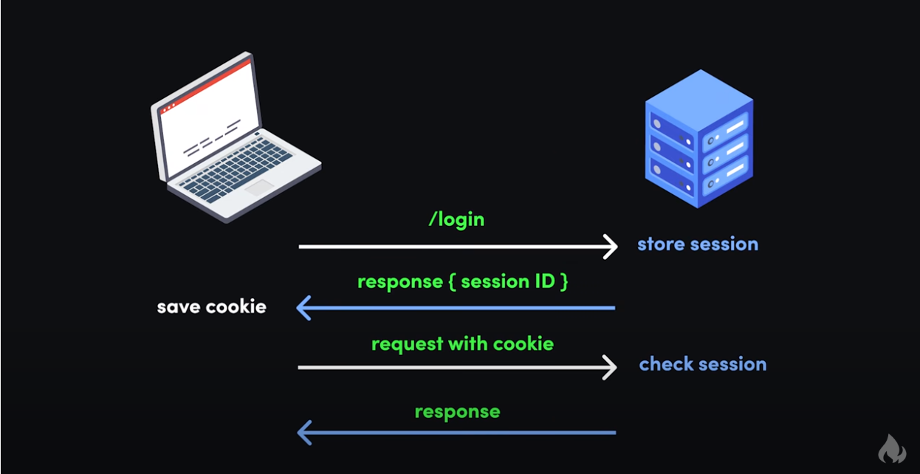

Slide 21
How to use Cookies - Limitations
Cookies are quite limited compared to some modern alternatives to storing data in the browser like localStorage or sessionStorage
Here's a rundown of cookies compared to those other technologies

Slide 22
How to use Cookies - Limitations
 | COOKIES | LOCAL STORAGE | SESSION STORAGE
Capacity | 4KB | 10MB | 5MB
Accessible from | Any window | Any window | Same tab
Expires | Manually set | Never | On tab close
Storage location | Browser and server | Browser only | Browser only
Sent with requests | Yes | No | No

Slide 23
How to use Cookies - Limitations
Cookies are an older technology, and have a very limited capacity
Still, there's quite a bit you can do with them
And their small size makes it easy for the browser to send cookies with each request to the server
It's also worth mentioning that browsers only allow cookies to work from one domain for security reasons

Slide 24
How to use Cookies - Limitations
So if you sign in to your bank at, say, ally.com, then cookies will only work within that domain and its subdomains
For example, your ally.com cookie will work on ally.com, ally.com/about, and the subdomain www.ally.com, but not axos.com.
This means that, even if you have accounts and are signed in at both ally.com and axos.com, those sites won't be able to read each other's cookies

Slide 25
How to use Cookies - Limitations
It's important to remember that your cookies are sent with every request you make in the browser
This is very convenient, but has some serious security implications
Just remember that cookies are meant to be openly read and sent, so you should never store sensitive information like passwords in them

Slide 26
How to Set a Cookie in JavaScript
Cookies are really just strings with key / value pairs
Though you'll probably work with cookies more on the backend, there may be times you'll want to set a cookie on the client side
Here's how to set a cookie in vanilla JavaScript:
document.cookie = 'dark_mode=true'

Slide 27
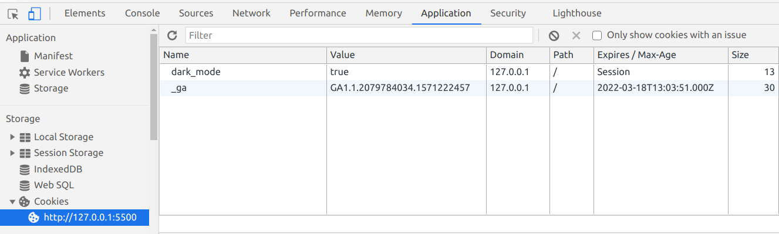
How to Set a Cookie in JavaScript
Then when you open the developer console, click "Application" and then on the site under "Cookies", you'll see the cookie you just added

Slide 28
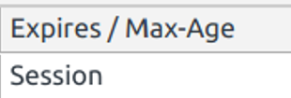
How to Set a Cookie in JavaScript
If you take a closer look at your cookie, you'll see that its expiration date is set to Session
That means the cookie will be destroyed when you close your tab / browser
That might be the behavior you want, like for an online store with payment information
But if you want your cookie to last longer, you'll need to set an expiration date

Slide 29

How to set an Expiration Date
// expires 1 week from now
document.cookie = 'dark_mode=true; expires=Fri, 26 Feb 2021 00:00:00 GMT'

Slide 30
How to set an Expiration Date
Or you could use the max-age attribute with the number of seconds you'd like your cookie to last:
// expires 1 week from now
document.cookie = 'dark_mode=true; max-age=604800';

Slide 31
How to Update a Cookie in JavaScript
Whether or not your cookie has an expiration date, updating it is easy
Just change the value for your cookie, and the browser will automatically pick it up:
// expires 1 week from now
document.cookie = "dark_mode=false; max-age=604800";

Slide 32
How to set the path for a cookie in JavaScript
Sometimes you'll only want your cookie to work with certain parts of your website
Depending on how your website is set up, one way to do this is with the path attribute
Here's how to make it so a cookie only works on the about page at /about:
document.cookie = 'dark_mode=true; path=/about';

Slide 33
How to Set the Path for a Cookie in JavaScript
document.cookie = 'dark_mode=true; path=/about’;
Now your cookie will only work on /about and other nested subdirectories like /about/team, but not on /blog

Slide 34
How to delete a cookie in JavaScript
To delete a cookie in JavaScript, just set the expires attribute to a date that's already passed:
// 1 week earlier
document.cookie = 'dark_mode=true; expires=Sun, 14 Feb 2021 00:00:00 GMT';
You could also use max-age and pass it a negative value:
// 1 minute earlier
document.cookie = 'dark_mode=true; max-age=-60';

Slide 35
Security Concerns with Cookies
In general, cookies are very secure when implemented correctly
Browsers have a lot of built-in limitations that we covered earlier, partly due to the age of the technology, but also to improve security
Still, there are a few ways that a bad actor can steal your cookie and use it to wreak havoc

Slide 36
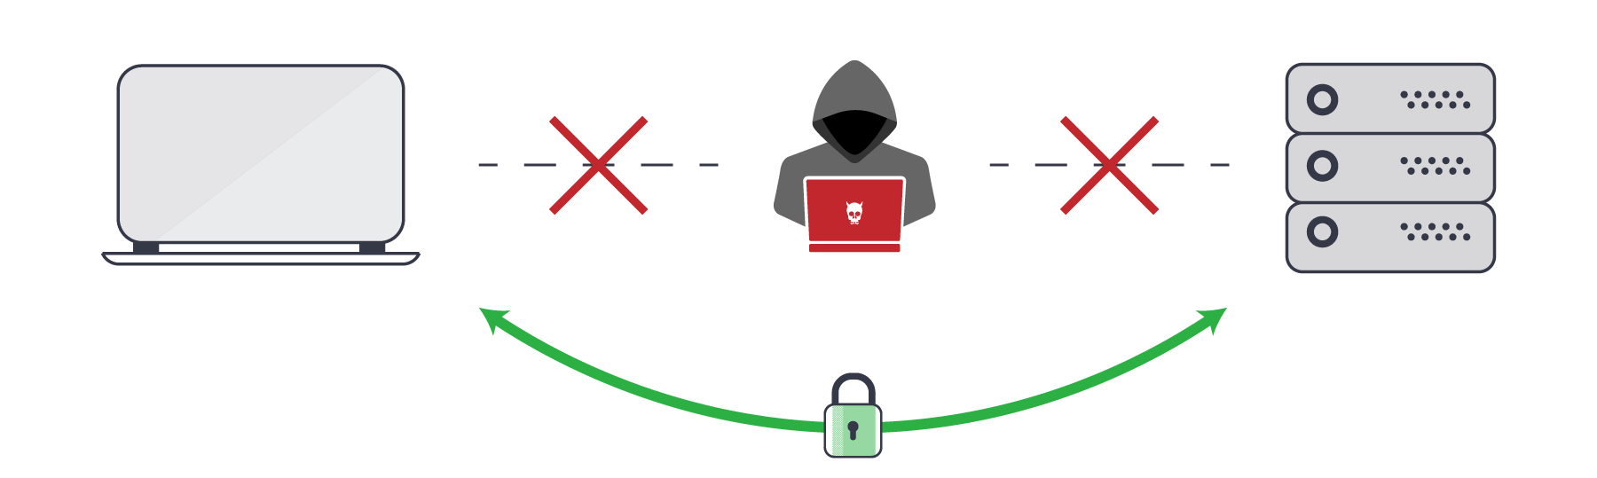
Man-in-the-middle Attacks
A man-in-the-middle (MitM) attack describes a broad category of attacks where an attacker sits between a client and a server and intercepts the data going between the two

Slide 37
Man-in-the-middle Attacks
This can be done in a lot of ways:
Gaining access to or listening in on an insecure website
Mimicking a public WiFi router
DNS spoofing
Malware / adware

Slide 38

Man-in-the-middle Attacks

Slide 39
Man-in-the-middle Attacks
As a developer, you can greatly reduce the chance of a MitM attack by ensuring that you enable HTTPS on your server, use an SSL certificate from a trusted certificate authority, and ensure your code uses HTTPS instead of the insecure HTTP
In terms of cookies, you should add the Secure attribute to your cookies so they can only be sent over a secure HTTPS connection:
document.cookie = 'dark_mode=false; Secure';

Slide 40
Man-in-the-middle Attacks
The Secure attribute doesn't actually encrypt any data in your cookie – it just ensures that the cookie can't be sent over an HTTP connection
However, a bad actor could still possibly intercept and manipulate the cookie
To prevent this from happening, you can also use the HttpOnly parameter:
document.cookie = 'dark_mode=false; Secure; HttpOnly';

Slide 41
Cross-Site Scripting (XSS) Attacks
An XSS (cross-site scripting) attack describes a category of attacks when a bad actor injects unintended, potentially dangerous code into a website
These attacks are very problematic because they could affect every person that visits the site

Slide 42
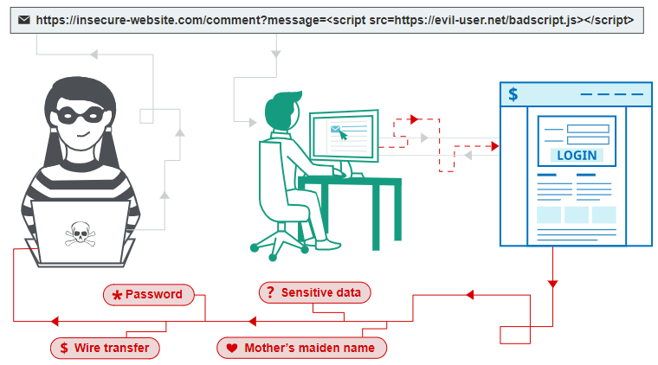
Cross-Site Scripting (XSS) Attacks

Slide 43
Cross-Site Scripting (XSS) Attacks
If a site has a comments section and someone is able to include malicious code as a comment, it's possible that every person who visits the site and reads that comment will be affected
In terms of cookies, if a bad actor pulls off a successful XSS attack on a site, they could gain access to session cookies and access the site as another signed in user
From there, they may be able to access the other user's settings, buy things as that user and have it shipped to another address, and so on

Slide 44
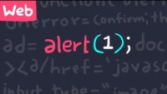
Cross-Site Scripting (XSS) Attacks

Slide 45
Cross-Site Request Forgery (CSRF) Attacks
A CSRF (cross-site request forgery) attack is when a bad actor tricks a person into carrying out an unintended, potentially malicious action
For example, if you're signed into a site and click on a link in a comment, if that link is part of a CSRF attack, it may lead to you unintentionally changing your sign in details, or even deleting your account

Slide 46
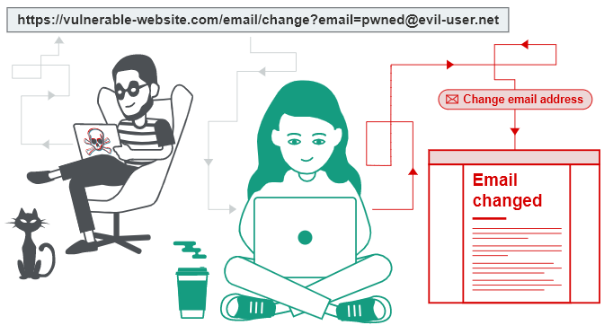
Cross-Site Request Forgery (CSRF) Attacks

Slide 47
Cross-Site Request Forgery (CSRF) Attacks
While CSRF attacks are somewhat related to XSS attacks, specifically reflected XSS attacks where someone inserts malicious code into a site, each preys on a different type of trust
According to Wikipedia, while XSS "exploits the trust a user has for a particular site, CSRF exploits the trust that a site has in a user's browser."

Slide 48

Cross-Site Request Forgery (CSRF) Attacks

Slide 49
Cross-Site Request Forgery (CSRF) Attacks
As for cookies, one way to prevent possible CSRF attacks is with the SameSite flag:
document.cookie = 'dark_mode=false; Secure; HttpOnly; SameSite=Strict';

Slide 50
Cross-Site Request Forgery (CSRF) Attacks
There are a few values you can set for SameSite:
Lax: Cookies are not sent for embedded content (images, iframes, etc.) but are sent when you click on a link or send a request to the origin the cookie is set for. For example, if you're on testing.com and you click on a link to go to test.com/about, your browser will send your cookie for test.com with that request
Strict: Cookies are only sent when you click on a link or send a request from the origin the cookie is set for. For example, your test.com cookie will only be sent while you're in and around test.com, and not coming from other sites like testing.com

Slide 51
Cross-Site Request Forgery (CSRF) Attacks
There are a few values you can set for SameSite:
None: Cookies will be sent with every request, regardless of context. If you set SameSite to None, you must also add the Secure attribute. It's better to avoid this value if possible
Major browsers handle SameSite a bit differently. For example, if SameSite isn't set on a cookie, Google Chrome sets it to Lax by default

Slide 52
Alternatives to Cookies
You might be wondering, if there are so many potential security flaws with cookies, why are we still using them? Surely there must be a better alternative
These days, you can use either sessionStorage or localStorage to store information that originally used cookies
For stateful sessions, there's token-based authentication with things like JWT (JSON Web Tokens)

Slide 53
Alternatives to Cookies
While it may seem like you have to choose between cookie-based or token-based authentication, it's possible to use both
For example, you might want use cookie-based authentication when someone signs in through the browser, and token-based authentication when someone signs in through a phone app
To muddy the waters a bit more, authentication-as-a-service providers like Auth0 allow you to do both types of authentication

Slide 54
Cookies
Despite all of the issues surrounding them, cookies are such an important part of web development that, should they disappear without a replacement, many of our favorite web applications would be rendered useless

Slide 55

Cookie Questions?

Slide 56
Sources:
https://www.redhat.com/en/topics/cloud-native-apps/stateful-vs-stateless
https://www.freecodecamp.org/news/everything-you-need-to-know-about-cookies-for-web-development/
https://en.wikipedia.org/wiki/Hypertext_Transfer_Protocol
https://www.youtube.com/watch?v=AwicscsvGLg
https://www.netsparker.com/blog/web-security/man-in-the-middle-attack-how-avoid/
https://portswigger.net/web-security/cross-site-scripting
https://portswigger.net/web-security/csrf

Slide 57


Copyrights
Presentation prepared by and copyright of John Ramsey, East Tennessee State University, Department of Computing . (ramseyjw@etsu.edu)
Microsoft, Windows, Excel, Outlook, and PowerPoint are registered trademarks of Microsoft Corporation.
IBM, DB2, DB2 Universal Database, System i, System i5, System p, System p5, System x, System z, System z10, System z9, z10, z9, iSeries, pSeries, xSeries, zSeries, eServer, z/VM, z/OS, i5/OS, S/390, OS/390, OS/400, AS/400, S/390 Parallel Enterprise Server, PowerVM, Power Architecture, POWER6+, POWER6, POWER5+, POWER5, POWER, OpenPower, PowerPC, BatchPipes, BladeCenter, System Storage, GPFS, HACMP, RETAIN, DB2 Connect, RACF, Redbooks, OS/2, Parallel Sysplex, MVS/ESA, AIX, Intelligent Miner, WebSphere, Netfinity, Tivoli and Informix are trademarks or registered trademarks of IBM Corporation.
Linux is the registered trademark of Linus Torvalds in the U.S. and other countries.
Oracle is a registered trademark of Oracle Corporation.
HTML, XML, XHTML and W3C are trademarks or registered trademarks of W3C®, World Wide Web Consortium, Massachusetts Institute of Technology.
Java is a registered trademark of Sun Microsystems, Inc.
JavaScript is a registered trademark of Sun Microsystems, Inc., used under license for technology invented and implemented by Netscape.
SAP, R/3, SAP NetWeaver, Duet, PartnerEdge, ByDesign, SAP Business ByDesign, and other SAP products and services mentioned herein as well as their respective logos are trademarks or registered trademarks of SAP AG in Germany and other countries.
Business Objects and the Business Objects logo, BusinessObjects, Crystal Reports, Crystal Decisions, Web Intelligence, Xcelsius, and other Business Objects products and services mentioned herein as well as their respective logos are trademarks or registered trademarks of Business Objects S.A. in the United States and in other countries. Business Objects is an SAP company.
ERPsim is a registered copyright of ERPsim Labs, HEC Montreal.
Other products mentioned in this presentation are trademarks of their respective owners.

