Slide 1

Introduction to TypeScript in Web Design
East Tennessee State University Department of Computing
CSCI 1720 Intermediate Web Design

Slide 2
Introduction to TypeScript
What is TypeScript?
A superset of JavaScript that introduces static typing, making code safer and more predictable
Developed by Microsoft, transpiles to JavaScript, ensuring full compatibility across all browsers
Popular in web design and front-end frameworks (like Angular, React)
Used by Google, Slack, Airbnb, etc.
East Tennessee State University Department of Computing
CSCI 1720 Intermediate Web Design

Slide 3
Benefits of TypeScript in Web Design
Error detection: Detects errors at compile time, preventing runtime crashes
Better tooling: Auto-completion, type-checking, and better code navigation (IntelliSense in VSCode)
Scalability: Easier to maintain larger projects
East Tennessee State University Department of Computing
CSCI 1720 Intermediate Web Design

Slide 4

TypeScript Setup
Environment Setup:
Node.js and npm installation are prerequisites
Install TypeScript globally:
East Tennessee State University Department of Computing
CSCI 1720 Intermediate Web Design

Slide 5

TypeScript Setup
Environment Setup:
Node.js and npm installation are prerequisites
On lab machines, we may have to (like Sass) install TS on a per-project basis
East Tennessee State University Department of Computing
CSCI 1720 Intermediate Web Design

Slide 6

Integrating TypeScript in a Web Project
In a web design workflow, TypeScript can be used alongside popular frameworks like React or Angular
Set up TypeScript in a project:
East Tennessee State University Department of Computing
CSCI 1720 Intermediate Web Design

Slide 7

Basic TypeScript file
Create a .ts file, then compile to .js:
variable name
type
East Tennessee State University Department of Computing
CSCI 1720 Intermediate Web Design

Slide 8
TypeScript and JavaScript: Key Differences
JavaScript: Dynamically typed, types are determined at runtime
TypeScript: Statically typed, types are determined at compile-time
East Tennessee State University Department of Computing
CSCI 1720 Intermediate Web Design

Slide 9
Type Inference
TypeScript can infer types even without explicit annotations
East Tennessee State University Department of Computing
CSCI 1720 Intermediate Web Design

Slide 10
Typescript - Advantages
Error Detection:
TypeScript catches errors early, making the code more reliable
East Tennessee State University Department of Computing
CSCI 1720 Intermediate Web Design

Slide 11
Typescript - Advantages
Use of ES6 and Beyond:
TypeScript supports modern JavaScript features (ES6 and beyond), ensuring compatibility with all browsers by compiling to ECMAScript 5 or 6
East Tennessee State University Department of Computing
CSCI 1720 Intermediate Web Design

Slide 12
Typescript - Advantages
Better OOP Support:
TypeScript provides more robust Object-Oriented Programming features like classes, interfaces, and inheritance
East Tennessee State University Department of Computing
CSCI 1720 Intermediate Web Design

Slide 13
Core TypeScript Features for Web Development

Slide 14
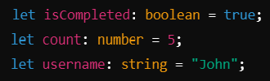
Type Annotations
Explicitly declare variable types for better control
East Tennessee State University Department of Computing
CSCI 1720 Intermediate Web Design

Slide 15
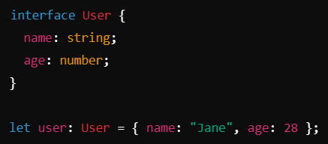
Interfaces
Define the shape of objects and ensure consistent data structures
East Tennessee State University Department of Computing
CSCI 1720 Intermediate Web Design

Slide 16
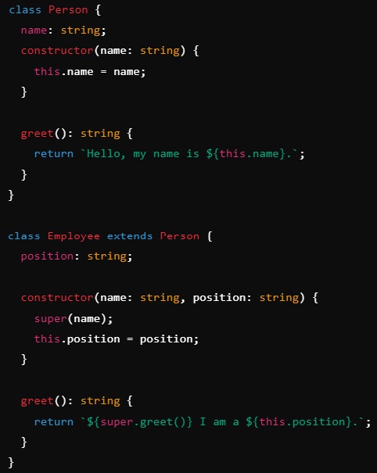
Classes and Inheritance
Object-Oriented Programming in TypeScript, similar to JavaScript but with better type
East Tennessee State University Department of Computing
CSCI 1720 Intermediate Web Design

Slide 17
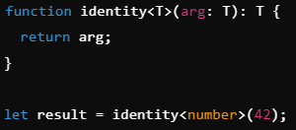
Generics in TypeScript
Create reusable components that work with any data type
East Tennessee State University Department of Computing
CSCI 1720 Intermediate Web Design

Slide 18
TypeScript in Web Design Projects
East Tennessee State University Department of Computing
CSCI 1720 Intermediate Web Design

Slide 19
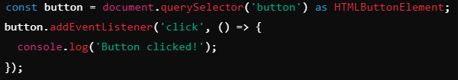
Using TypeScript with HTML and CSS
Example: Using TypeScript to manipulate the DOM
East Tennessee State University Department of Computing
CSCI 1720 Intermediate Web Design

Slide 20


Frameworks
Typescript also integrates well with frameworks like React and Angular
East Tennessee State University Department of Computing
CSCI 1720 Intermediate Web Design

Slide 21
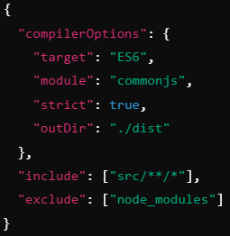
Configuring TypeScript with tsconfig.json
Why tsconfig.json?
A configuration file that defines how TypeScript compiles your code
Key configurations:
Strict Mode:
Always use "strict": true for better error checking and safer code
East Tennessee State University Department of Computing
CSCI 1720 Intermediate Web Design

Slide 22
Best Practices for TypeScript in Web Design
Use Type Inference: Let TypeScript infer types when possible to keep the code clean
Modular Code: Split your code into multiple files and modules to keep it manageable and organized
Strong Typing for Props and State (for React): Always define types for component props and state to prevent common bugs
East Tennessee State University Department of Computing
CSCI 1720 Intermediate Web Design

Slide 23
Best Practices for TypeScript in Web Design
Gradual Adoption: TypeScript can be adopted gradually, especially for existing JavaScript projects
Leverage Tooling: Use VSCode’s TypeScript integration for better auto-completion, refactoring, and navigation
East Tennessee State University Department of Computing
CSCI 1720 Intermediate Web Design

Slide 24
Summary
TypeScript adds value to web design by providing static typing, better tooling, and enhanced code scalability
Integrates seamlessly with modern frameworks like React and Angular
East Tennessee State University Department of Computing
CSCI 1720 Intermediate Web Design

Slide 25

East Tennessee State University Department of Computing
CSCI 1720 Intermediate Web Design

